Slide 1
Town of Jackson
Tanya Anderson
Ecosystem Stewardship Administrator

Slide 2
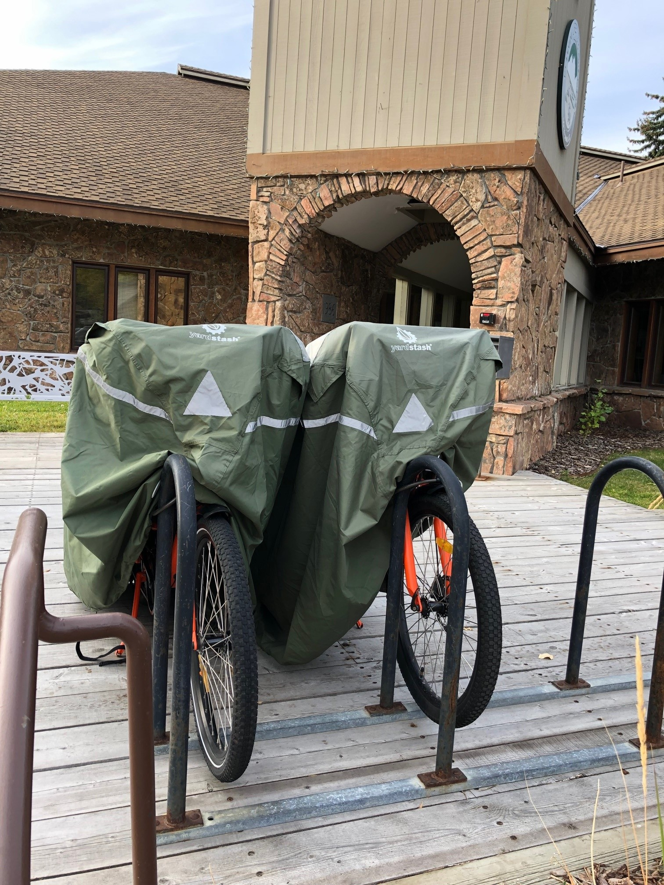
Workplace incentives for transportation alternatives
Town of Jackson incentives
50% off bus passes
Bike parking & showers
6 Workplace E-bikes
Workplace EV charging
Town goal: Reduce emissions from staff commutes 20% by 2030.

Slide 3
Barriers to Transportation Alternatives
Things we can’t fix at a workplace scale:
Work late or irregular hours (34%)
Convenience (29%)
Commute time (20%)
Things with workplace solutions:
Use my car to run errands during the day (25%)
Need to drop off/pick up kids (17%)
Ability to get home in an emergency (14%)
What we didn’t see:
Cost of bus pass or E-bike (0)
Difficult to find others to rideshare with (0)

Slide 4
Incentives for commute alternatives
Biggest bang for the buck
Telecommute option (32%) (#2)
Flexible work hours (31%) (#3)
Opportunities to get creative!
Financial incentives for active transit (34%) or carpooling (17%)
Worthwhile investments
On-site services such as showers, childcare, or food service (14%)
Guaranteed ride home (8%)
Improved bike parking (8%)

Slide 5
teton raptor center’s
2023
Lot Liberation Quest

Slide 6
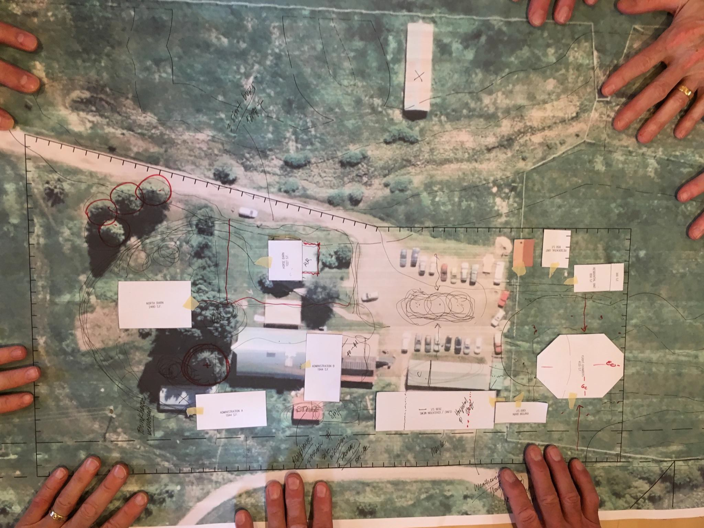
Parking Allowed: (38)
34 Regular
2 ADA
2 Bus
Daily Parking Needs: (20)
5 Fleet
4 Resident
10-12 Staff & Volunteers

Slide 7
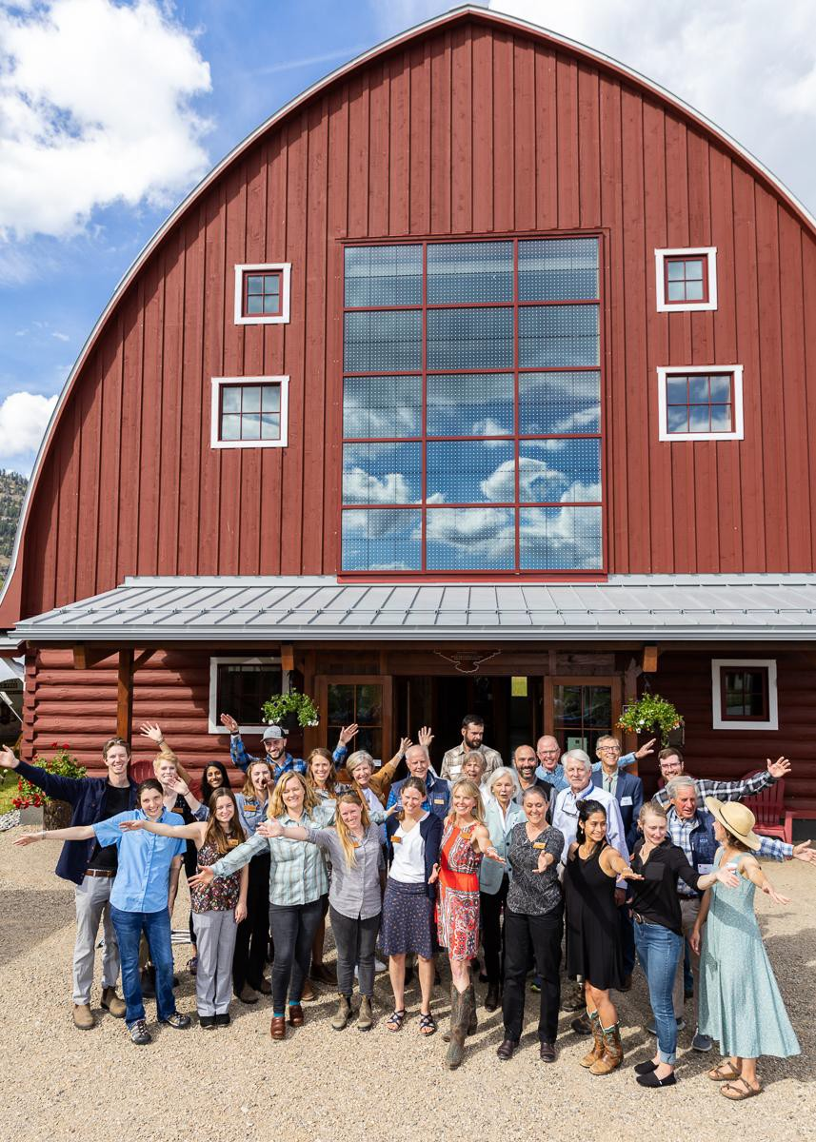
MOTIVATION & GOALS
Welcome people to our new campus.
Liberate parking spaces by incentivizing staff and volunteers to free up parking spaces by walking, biking, and carpooling.
Provide tools.
Award Prizes.

Slide 9
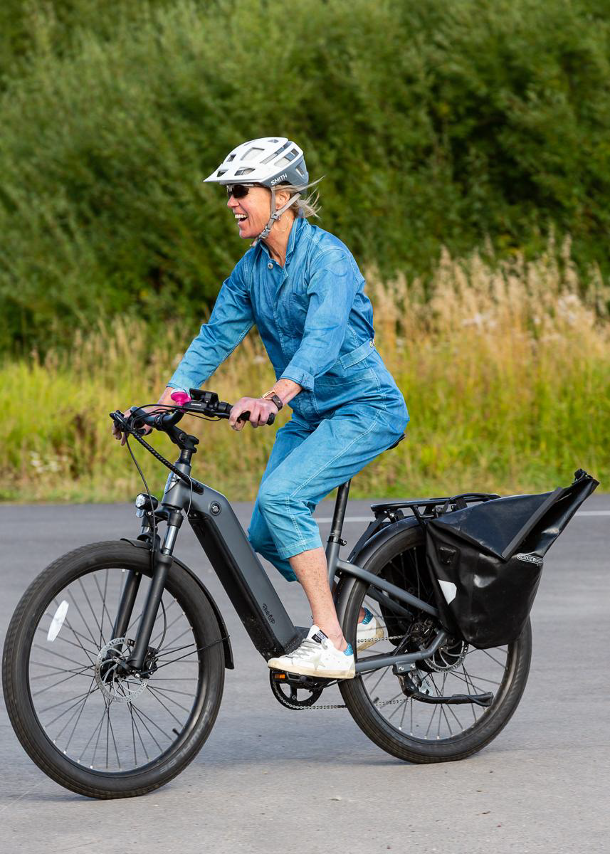
RESULTS
215 parking spots liberated (June - Sept)!
160 by staff
55 by volunteers

Slide 10
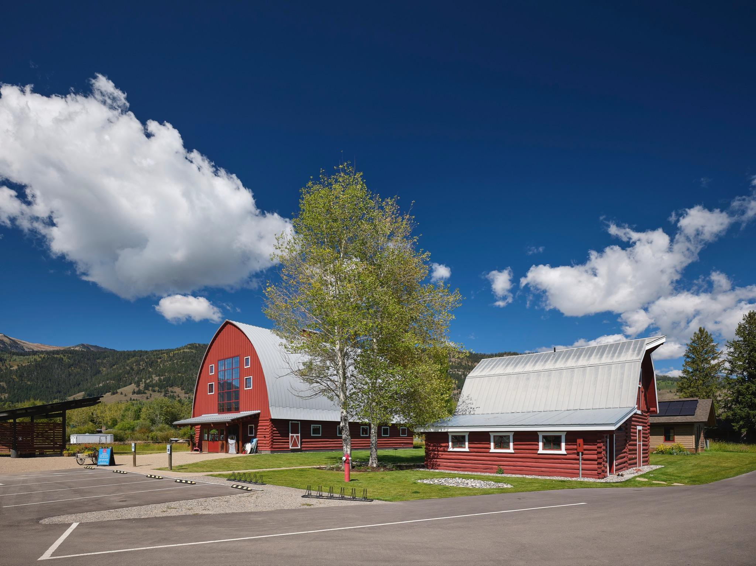
LEARNING & OPPORTUNITIES
Switch up the prizes
New Pathway direct to TRC
Bus

Slide 11
Sustainable Commuting Incentive Program
Teton Toys’ Program Review

Slide 12
What is SCIP?
In the summer of 2018, Teton Toys initiated and managed a downtown parking incentive program which included about a dozen partners. Through this program, we tracked how about 200 employees collectively got to and from work and offered points for various behaviors. At the end of the summer, we hosted a party and distributed prizes.
This year, we adopted an internal incentive program to encourage employees to use more sustainable methods of getting to work. Through this program, we incentivize sustainable behaviors and are able to track the carbon footprint generated by our staff’s commutes.
When onboarding, new employees are given a commuting questionnaire to fill out and an introduction to the program. This questionnaire provides the company with the primary method used to get to work as well as the specs about the vehicle used to commute (if any) so that CO2 emission calculations can be made.

Slide 14
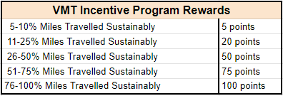
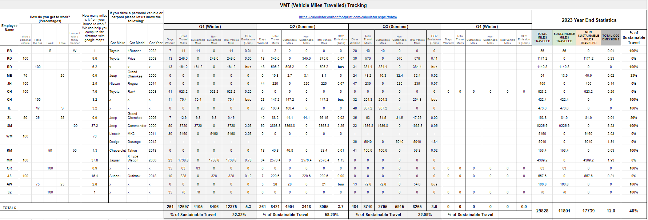
Our staff members accumulate points earned for different incentives throughout the year and exchange those points for gift cards to use at a list of at least 50 different companies. They can also exchange the points for in store credit. 1 point is the equivalent of $1.

Slide 15
Overview of Obstacles
Obstacles
Successes
Zero public downtown bike parking options
Limited START options, particularly for commuters who work after 5 PM.
Winter weather makes it harder to walk/bike
Tracking mechanism not 100% accurate
Developing data to track our carbon footprint
Offering to subsidize commuter bus passes has increased morale, though the limited service schedule (none on nights or weekends) has limited its real impact.
Opportunity for team building toward individual and common goals (points are awarded individually to the employee and collectively to the store).

Slide 16
The Future of the SCIP Program
Assessment of a company carpool/vanpool (which could include other local partners).
Engaging with START and attending public meetings to highlight the issues that employees face with limited commuter service schedules.
Instead of purchasing carbon credits that don’t necessarily go to our community directly, we either hope to engage our team in a local tree planting initiative or contribute those carbon-credit dollars locally.
Work with our programer to create a prompt with employee clock in asking method of travel that day

Slide 24
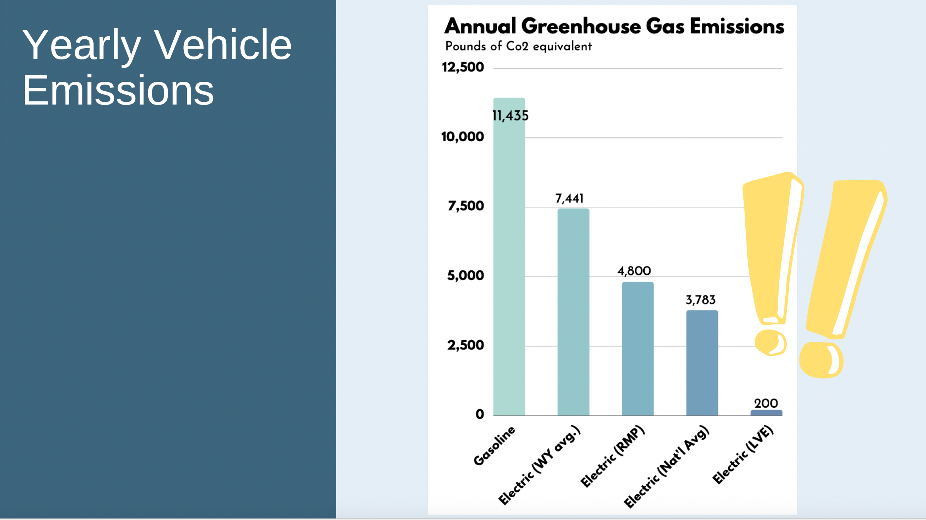

Slide 30
